Slide 1
Obstructed labour
Queensland Maternity Education
Maternity Emergency Program
Notes:
Introduce the session using the PowerPoint presentation and review the outcomes on slide 2.

Slide 2
Learning outcomes
Identify key risk factors associated with obstructed labour
Apply shared decision-making principles when discussing interventions
Detect delays in labour progress and initiate timely escalation of care
Notes:
Introduce the session using the PowerPoint presentation and review the outcomes on slide 2.

Slide 3
How would you define obstructed labour?
Notes:
Using slide 3, elicit a few definitions of obstructed labour from participants based on the pre-reading, their knowledge and experience, before moving on to slide 4 and showing the definitions from the Queensland Clinical Guideline – Prolonged and/or obstructed labour – Short Guide and Queensland Clinical Guideline – Normal birth.

Slide 4
Obstructed labour – definition
‘Despite strong, effective uterine contractions there is a ceasing in the progress of labour.’
Queensland Clinical Guideline – Prolonged and/or obstructed labour - Short Guide
Normal progress of labour - definition
0.5 cm progress per hour (or 2cm in 4 hours)
Queensland Clinical Guideline: Normal birth

Slide 5
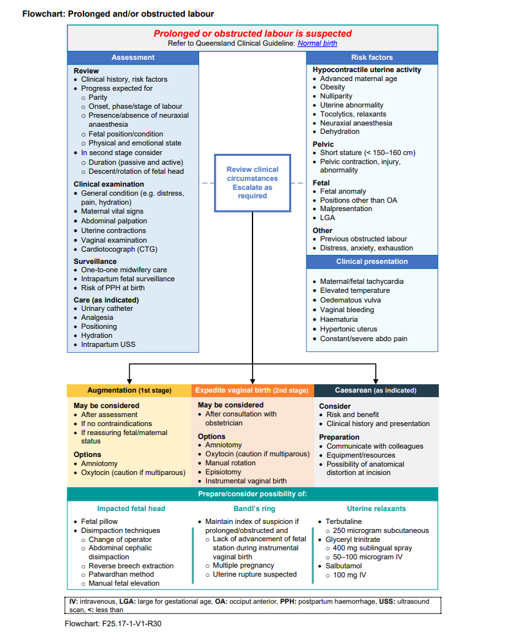
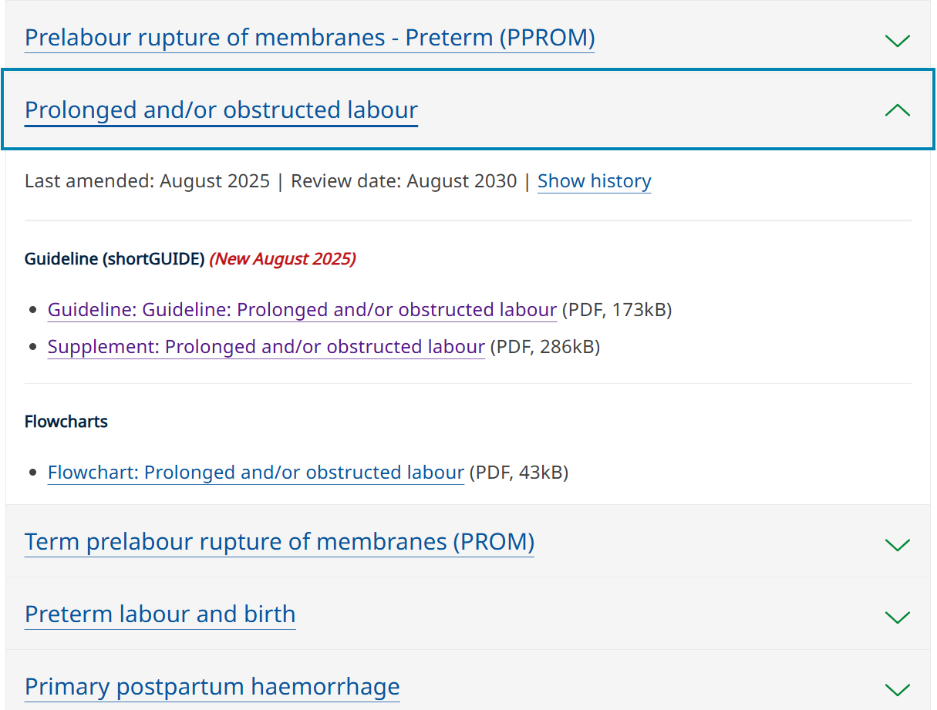
New guideline – Prolonged and/or obstructed labour
Notes:
Show participants slide 5 and encourage them to access the new guideline on QHEPS.
QLD Clinical Guideline: Prolonged and/or obstructed labour (released August 2025)
If you haven’t already accessed the pre-reading for this session, we would encourage you to check out the MEP resource kit on obstructed labour and impacted fetal head via the CSDS website under Queensland Maternity Education (QME).

Slide 6
What causes obstructed labour or may contribute to obstructed labour?
Notes:
Ask participants to provide examples of what causes or contributes to obstructed labour based on the pre-reading, their knowledge and experience, before moving on to slide 7 and eliciting any factors affecting progression of labour not already mentioned.

Slide 7
Obstructed Labour
Causes and contributing factors to obstructed labour:
Hypocontractile uterine activity
Pelvic factors
Fetal factors
Other considerations
Notes:
Factors Affecting Progression of Labour – Sourced from QCG obstructed and/or prolonged labour
Ask participants to provide examples of each:
Hypocontractile uterine activity
Advanced Maternal Age
Obesity
Nulliparity
Diabetes complicating pregnancy
Uterine abnormality
Tocolytics, relaxants
Neuraxial anaesthesia
Dehydration
Pelvic Factors
Short stature (less than 150-160cm)
Pelvic contraction/injury or abnormality (e.g. narrow subpubic arch, prominent sacrum)
Fetal Factors
Fetal anomaly resulting in cephalopelvic disproportion (CPD)¹³
Positions other than occiput anterior^{14,15}
Malpresentation¹³
Hydrocephalus
Large for gestational age, macrosomia, increased fetal abdominal circumference
Other Considerations:
Previous obstructed labour
Psychological state (fear of childbirth, anxiety, exhaustion)

Slide 8
What are some key clinical signs associated with obstructed labour?
Notes:
Elicit key clinical signs associated with obstructed labour before moving on to slide 9 and showing the signs listed in the Queensland Clinical Guidelines: Prolonged and/or obstructed labour short guide.

Slide 9
Obstructed labour – key clinical signs
Prolonged active phase of labour
Lack of descent despite good contractions
Slowing/ceasing of cervical dilation
Oedematous vulva or cervix
Hypertonus with frequent strong contractions
Vaginal bleeding
Haematuria
Maternal exhaustion or distress
Maternal pyrexia
Rising blood pressure
Maternal and/or fetal tachycardia
Constant severe abdominal pain
Fetal distress/abnormal CTG
Physiologic retraction ring (Bandl’s ring)

Slide 10

Discussion – obstructed labour
Notes:
Ask 1-2 additional questions, time permitting. (5 mins)
Some suggestions are:
What can a woman do to reduce her chances of an obstructed labour?
- regular antenatal care
- optimal fetal positioning
- good nutrition and hydration in labour
- delay hospital admission until in active labour
- mobilise and use upright positions in labour
- be informed and involved in their care
What can clinicians do to reduce a woman’s chance of obstructed labour?
- support a woman with the above
- limit unnecessary interventions
- foster respectful communication
- provide one-on-one continuous midwifery labour and birth support
When should you escalate your concerns (and to who) if you suspect obstructed labour?
- team leader should be kept well informed of labour progress
- obstetric team should be notified at earliest convenience of delays in progress outside of the normal progress of labour definition
What complications can occur from obstructed labour?
Maternal:
- Operative interventions (instrumental vaginal birth, caesarean birth)
- Chorioamnionitis, endometritis
- Obstetric anal sphincter injury
- Obstetric fistula (rare in developed countries)
- Primary postpartum haemorrhage
- Postpartum urinary retention
- Uterine rupture
- Psychosocial/psychological sequalae
Neonatal:
- Admission to a neonatal unit
- Respiratory distress syndrome
- Confirmed or suspected sepsis
- Birth asphyxia-related complications, which progressively increase with duration of first or second stage
- Birth injury (e.g. fractures of skull, clavicle, femur)
- Fetal/neonatal death may occur
(sourced from QCG – obstructed and/or prolonged labour short guide)

Slide 11

Case study (25 mins)
This is an opportunity for team collaboration, use of clinical judgment and a discussion on the potential needs and perspective of the woman.
Notes:
Introduce the case study discussion activity.
Let participants know that they’ll be working through a scenario in a group, coming up with a plan of care based on the information in the case study.
Each group will receive information about the woman (Talia) as the scenario plays out in the form of time point handouts (pgs. 38-42 of resource kit).
Groups will make a plan of care for Talia based on each time point using the shared decision-making process.
At the end, groups will each share their plan of care with the other participants.
As there will be different clinical backgrounds/experiences/assumptions among the different group members, each group may come up with a different plan of care – and that’s ok! Remind participants that this activity is a good opportunity to collaborate as a team and apply the shared decision-making process displayed on slide 13.

Slide 12
Case study – learning objectives
Identify key risk factors associated with obstructed labour
Apply shared decision-making principles when discussing obstetric interventions
Detect delays in labour progress and initiate timely escalation of care
Notes:
Show participants the learning objectives for the case study to reinforce the expectations for the activity.

Slide 13
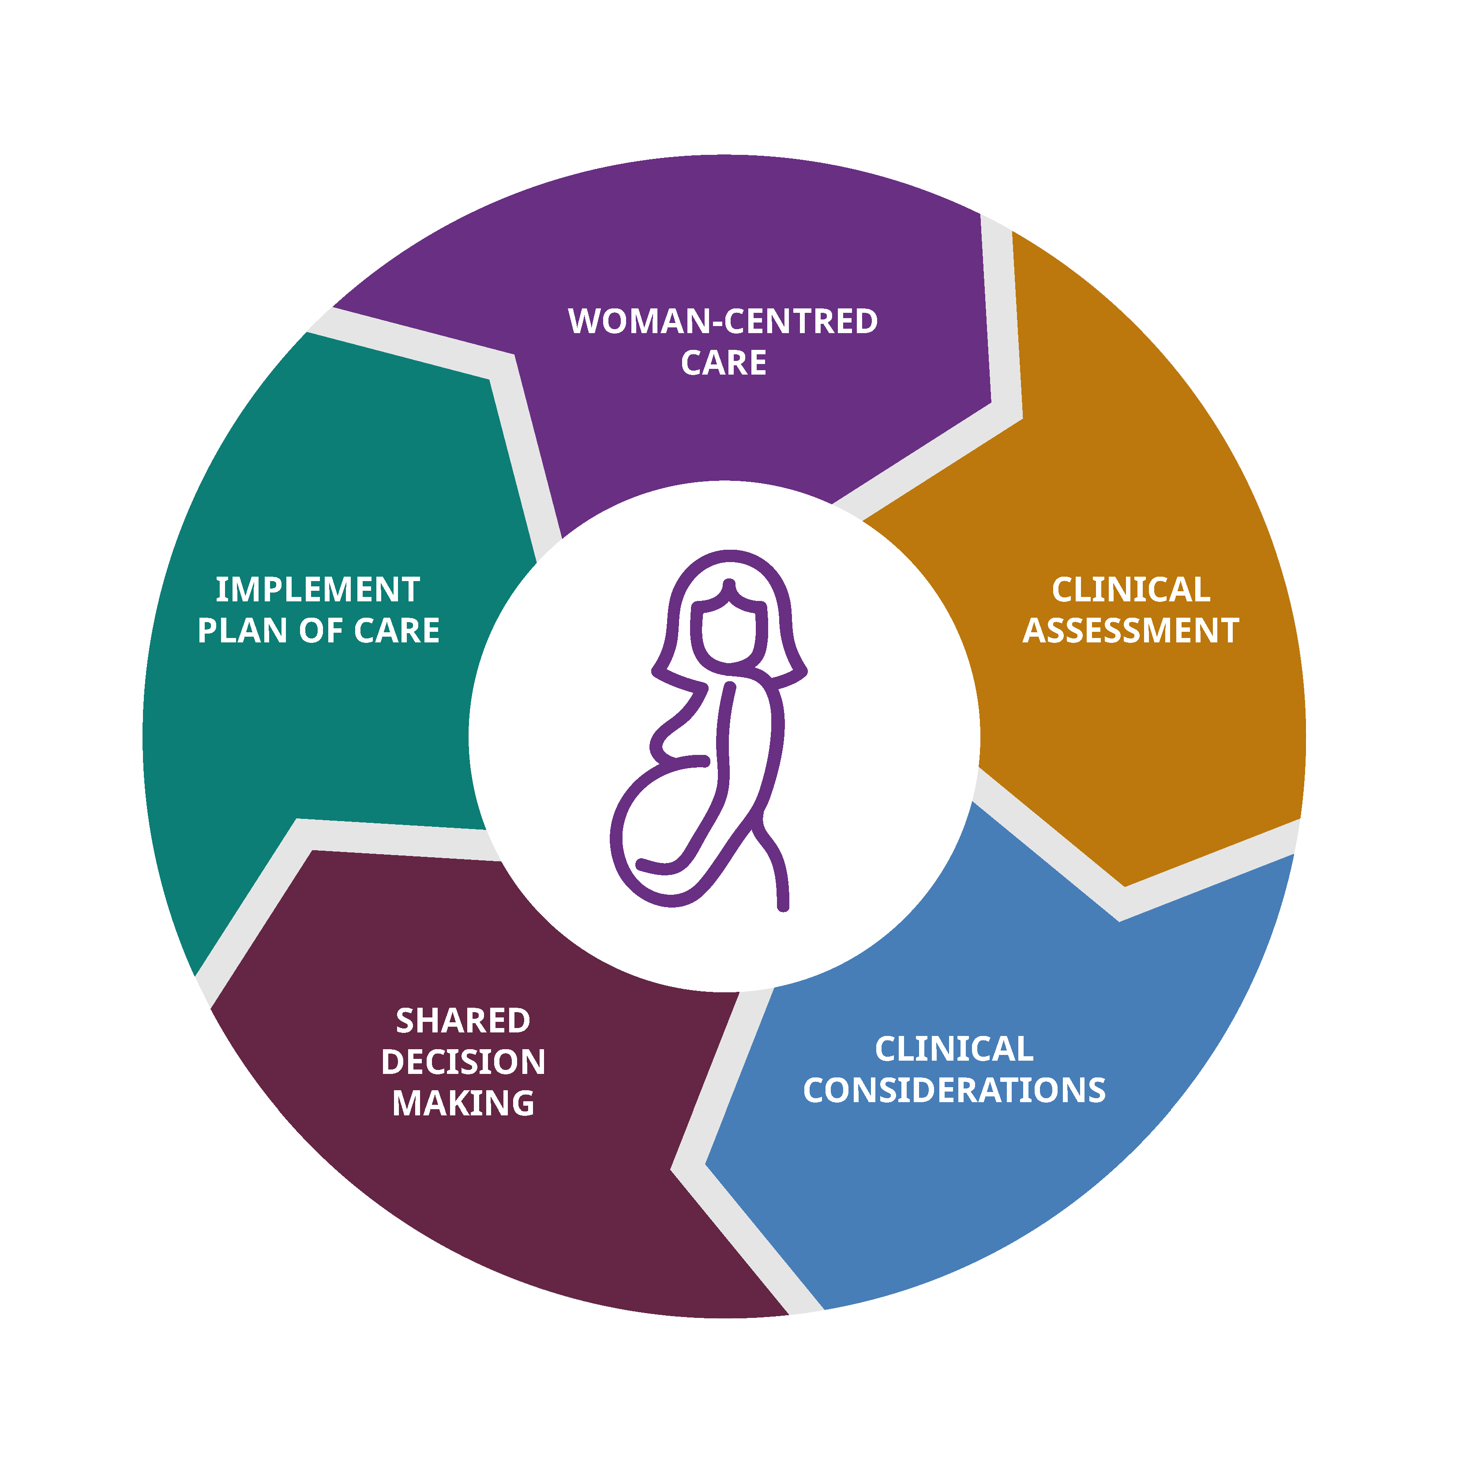
Case study – Talia
Create a plan of care (25mins)
You will be given a scenario card that focuses on a time point within the case study.
Each group will make an appropriate plan of care for that time point utilising the shared decision-making process.
Once you have completed a time point, ask the facilitator for the next one, until your group has reached a mode of birth.
Notes:
Set up the activity.
Give each group the following materials:
a copy of Time point 1 pens/pencils/markers
a blank partogram
a copy of the Shared decision-making process infographic
Note: The Time point 1 handout has a space for you to write in the birthing facility level to better contextualise the case study to the participants’ facility or a level facility chosen by the facilitator.
Allow some time to answer any questions before the activity begins
Ask participants to begin, reminding them to ask for the next time point once they’ve finished their current one.
Participants will continue working through the time points until they make the decision for an instrumental birth, or caesarean section.
(If at any point the group decide to do an instrumental birth, give them the Instrumental birth time point. After they have completed the instrumental birth card, they will be advised that the instrumental birth was successful.)
Any groups that proceed to an instrumental birth or caesarean section, will need to wait until the other group/s catch up to the decision to do a caesarean section or an instrumental birth.
If a group has a CTG as part of their plan of care, provide it to them with their next timepoint sheet. For example, if a group requests a CTG at Time point 1, provide them with the Time point 2 – CTG handout along with the Time point 2 handout, once they’ve finished their plan of care for Time point 1.
Note: If there is a simulated participant available to play the role of Talia, encourage groups to consult with them at each time point to better practice the shared decision-making process. Provide the simulated participant guidance notes to the simulated participant (located in the resource kit).

Slide 14

Present your plan of care
Nominate someone to present your plan of care for each time point.
Notes:
Present plans (10mins)
Get each team to nominate a presenter.
The nominated presenter for group A presents their plan of care for each time point and the rationale behind their decision.
Other groups are to actively listen to the presenting group and not contribute until all groups have presented their plans of care for each time point. Emphasise that there is no right or wrong answer as it will depend on other maternal and facility circumstances, not provided within the scenario, however they will be provided with the opportunity for open discussion and sharing of knowledge at the next step.
Once Group A have presented their timelines, plans of care and rationale, move onto Group B and continue this process until all groups have presented their timelines and plans of care.

Slide 15
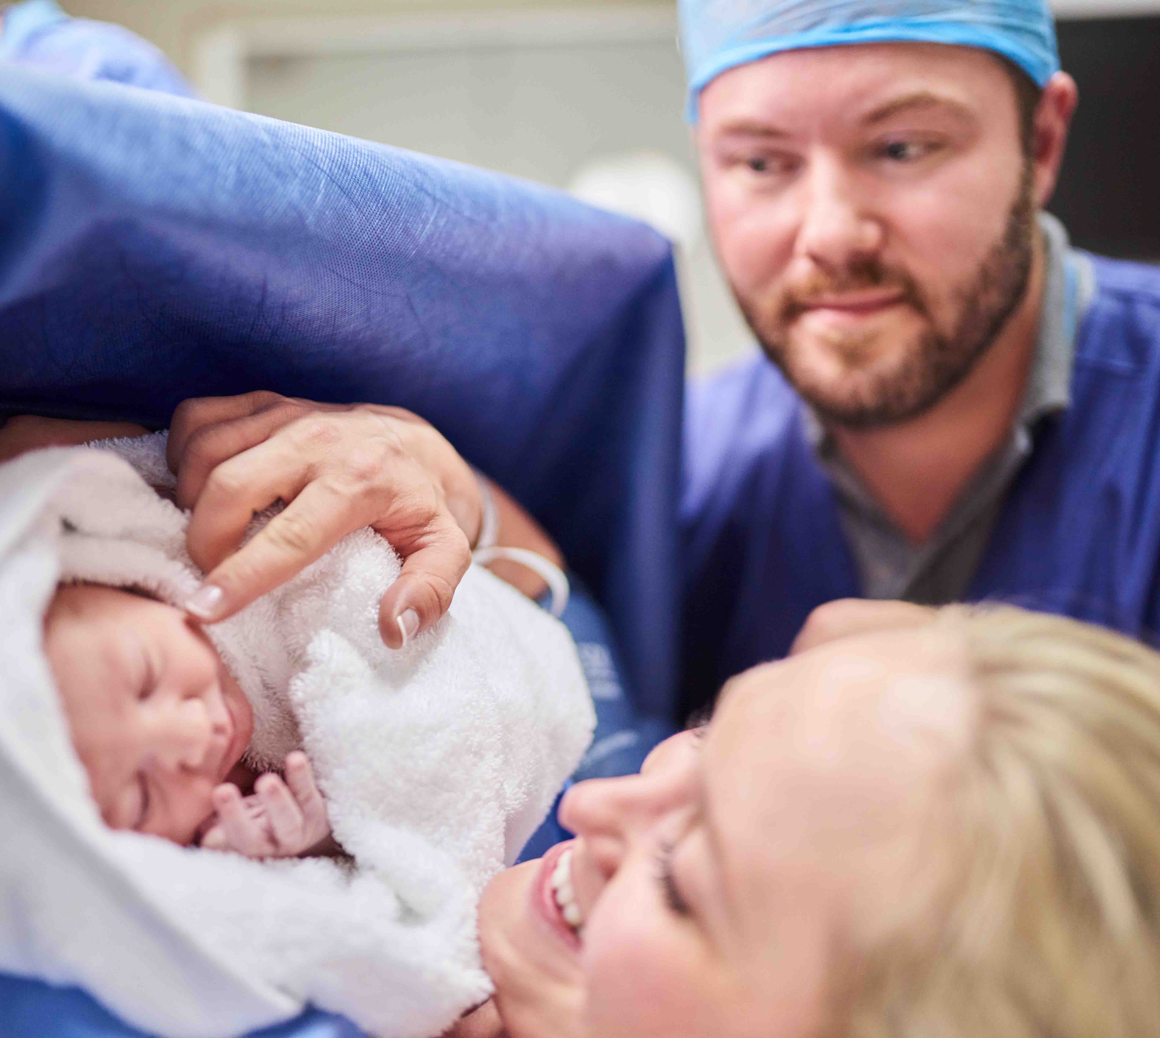
Case study - Outcome
Through recognition of risk factors for obstructed labour, shared-decision making and the provision of woman-centred care:
Talia’s baby is born with Apgar’s of 7 & 9. Tactile stimulation provided. Weight 4070g.
Despite requiring intervention to birth her baby, Talia felt well informed and supported through the decisions that were made throughout her labour and birth.
Notes:
We acknowledge the challenges associated with timely recognition and shared decision making in real life situations.
Women may decline recommended care or be wanting interventions before medically indicated or clinicians may disagree with each other on recommended management and navigating these complex conversations can at times be challenging for clinicians.
Remember if you’ve had a challenging situation, you can:
Reach out to your line manager or talk to a colleague or friend
Participate in a clinical debrief session after the event
Practice self-care principles for personal health and wellbeing
Utilise your employee support services such as Employee Assistance Service (EAS) and peer-support programs.

Slide 16
Summary
The case study has offered a valuable opportunity to identify key risk factors, initiate timely escalation and apply shared decision-making principles to enhance maternity care.
You can apply the shared decision-making process in your clinical practice to:
facilitate meaningful conversations and respectful communication with women about their values and preferences
integrate your clinical assessments and professional judgement
provide evidence-based recommendations aligned with current guidelines and research
support women with informed decision making and consent
deliver authentic, woman-centred care that supports positive outcomes for women and their newborns.

